Slide 1
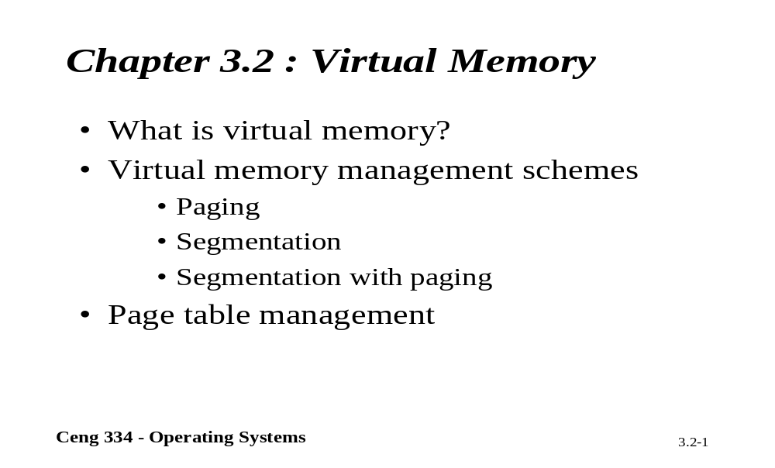
Chapter 3.2: Virtual Memory

Slide 2
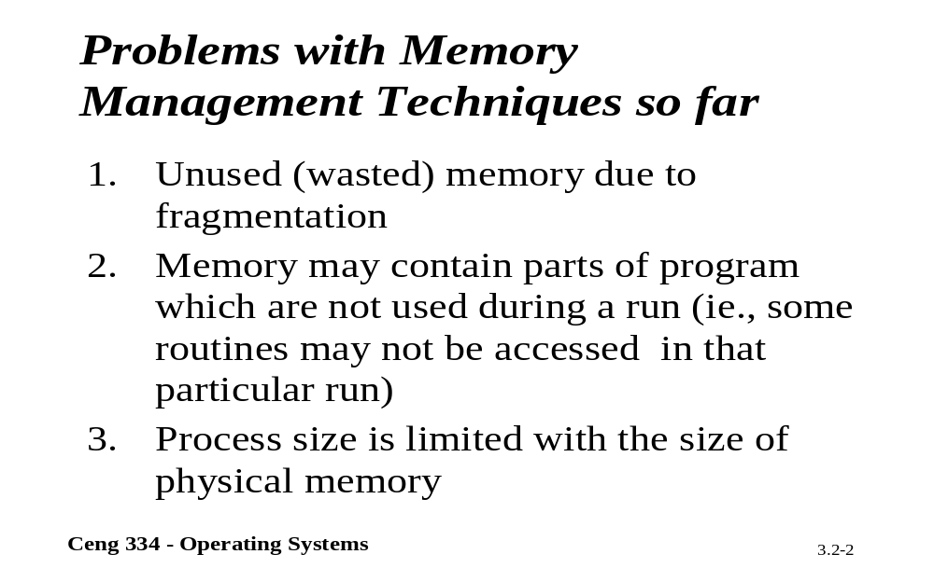
Problems With Memory Mang.

Slide 3
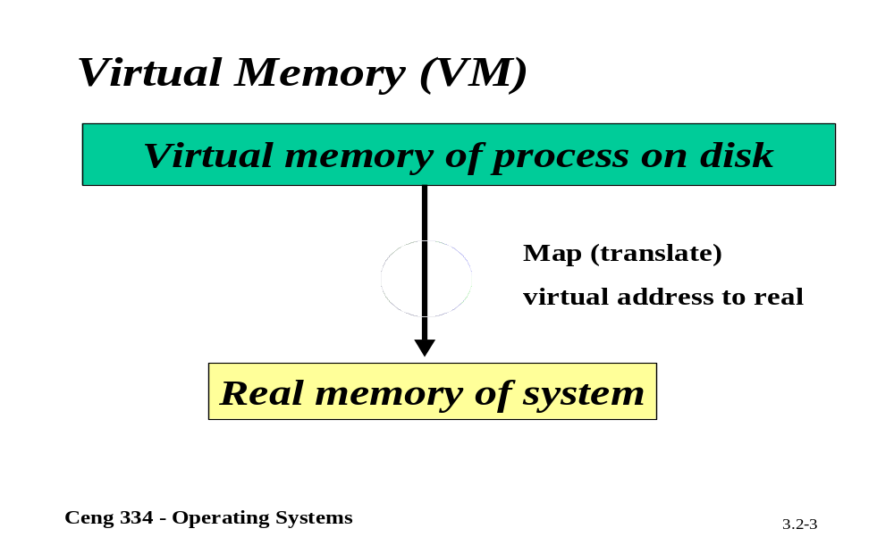
Virtual Memory

Slide 4
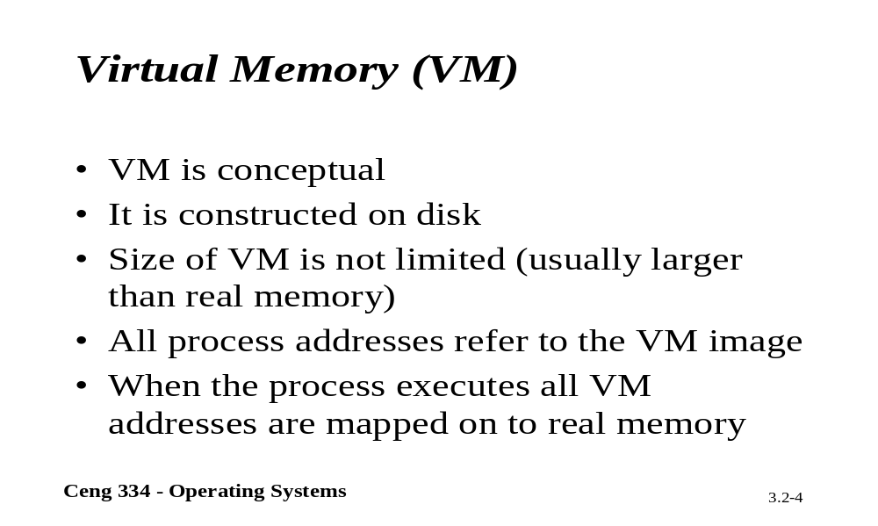
Virtual Memory

Slide 5
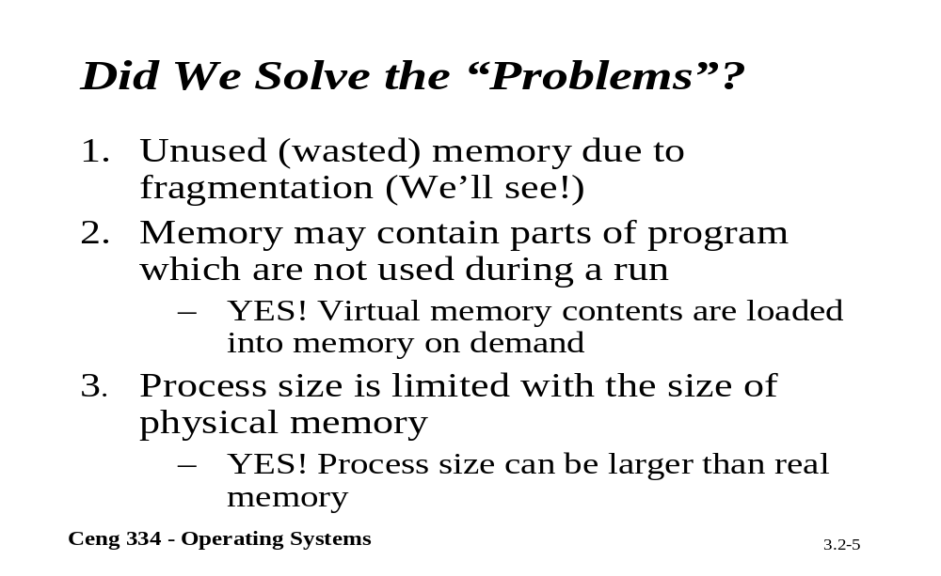
Problems Solved?

Slide 6
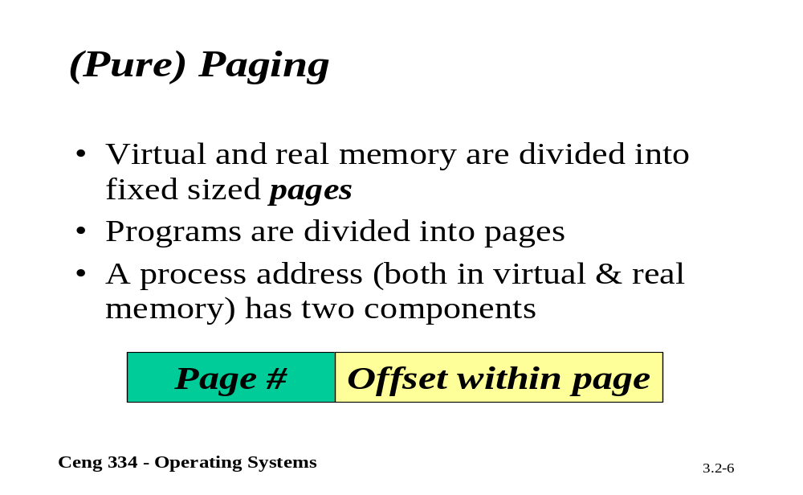
Pagging

Slide 7
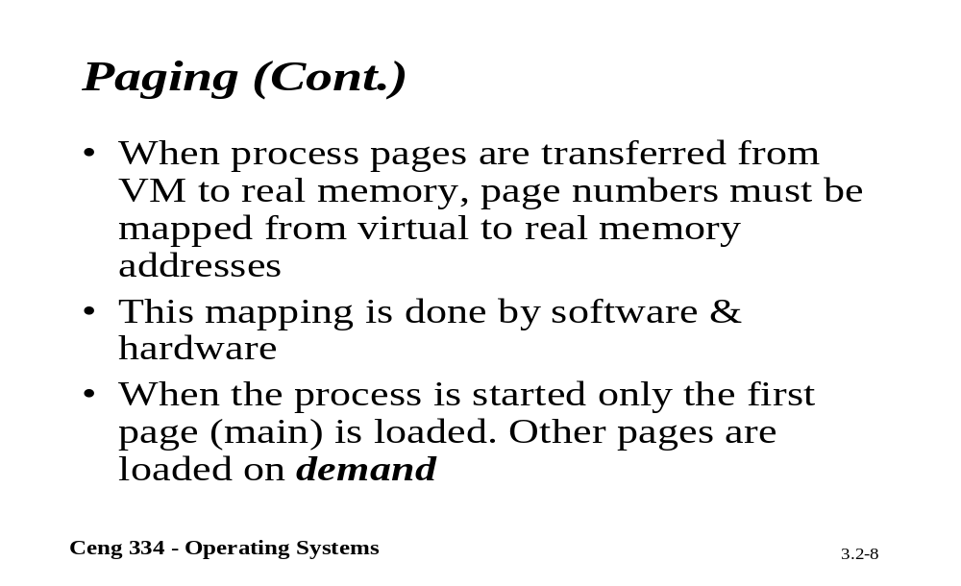
Pagging

Slide 8
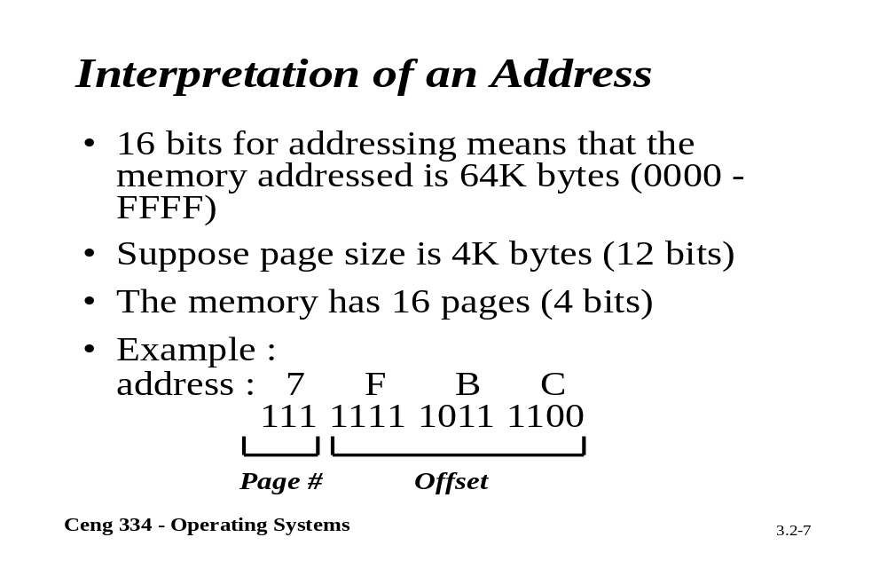
Intyerpretation Of an Address

Slide 9
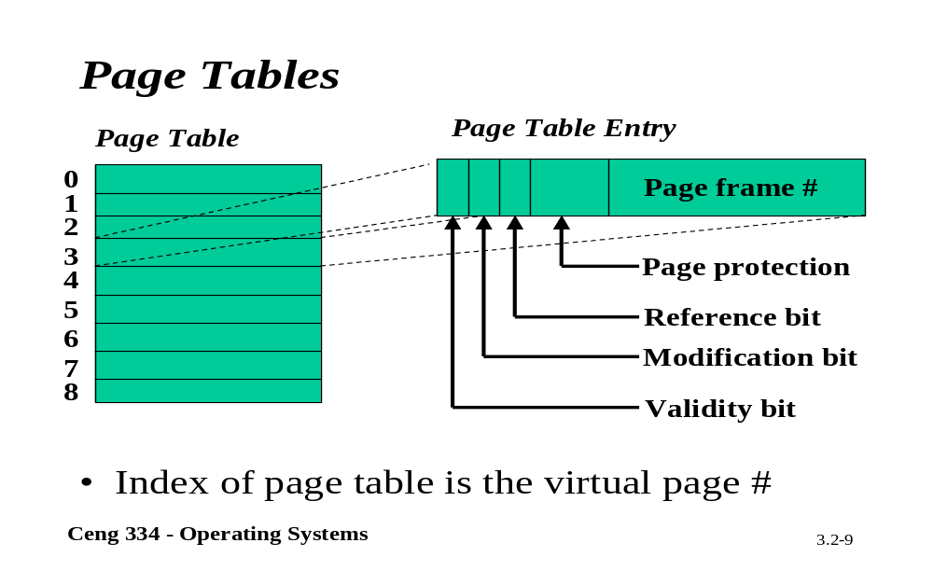
Page Tables

Slide 10
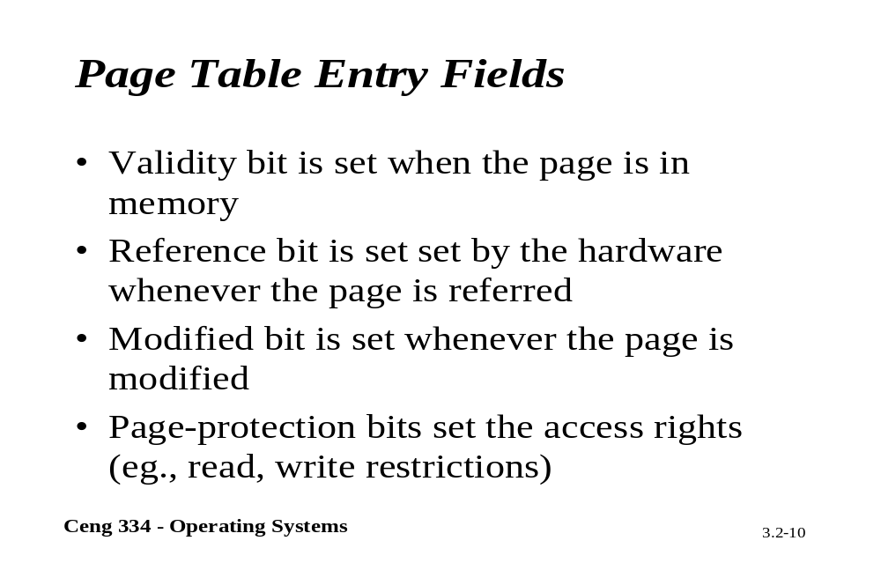
Page Table Entry Fields

Slide 11
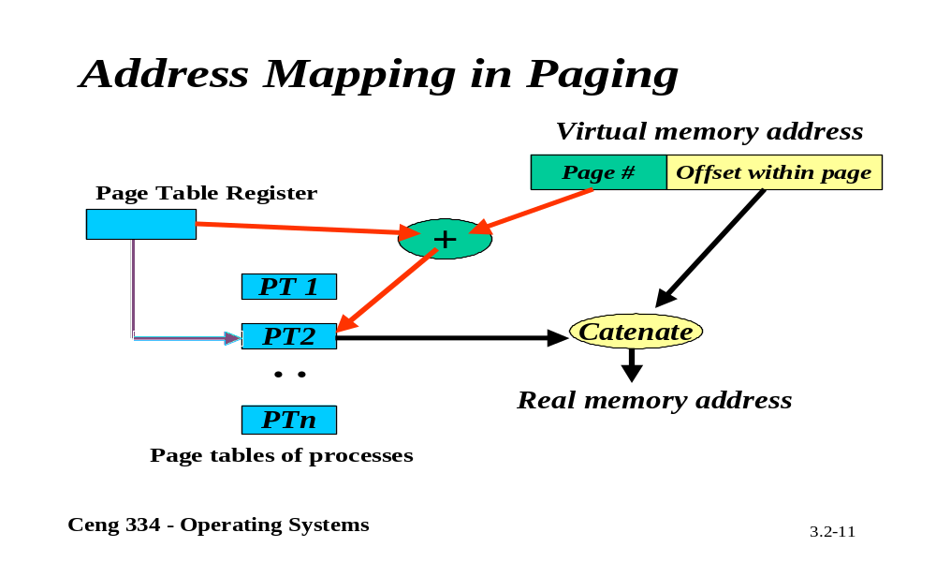
Adrress Mapping

Slide 12
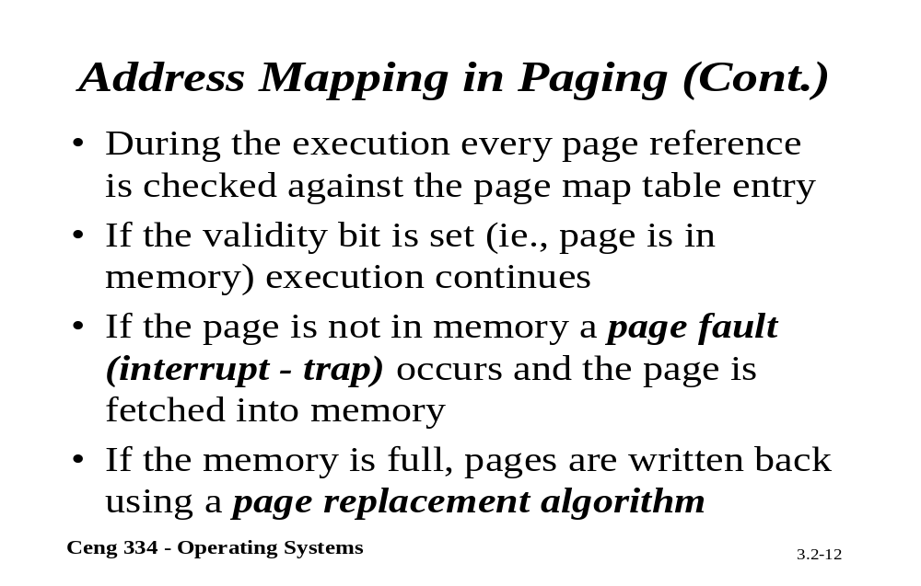
Address Mapping

Slide 13
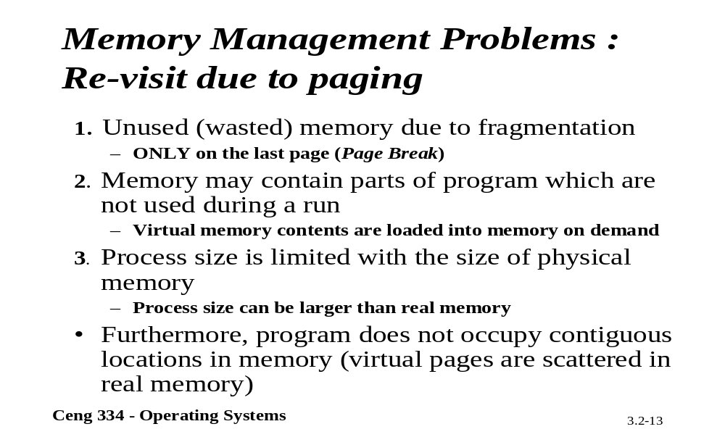
Re-visst Due to Pagging

Slide 14
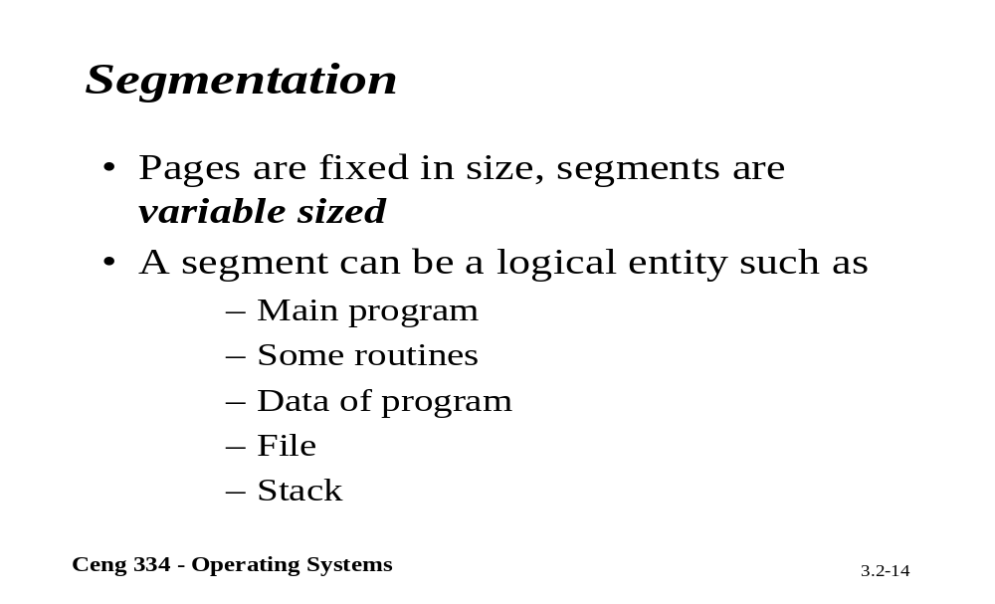
Segmentation

Slide 15
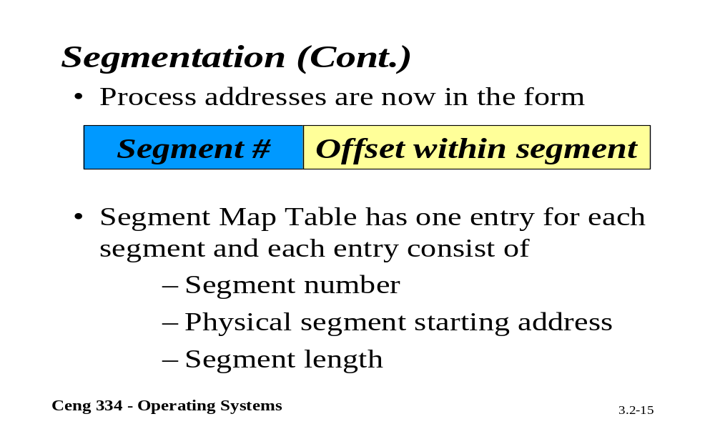
Segmentation

Slide 16
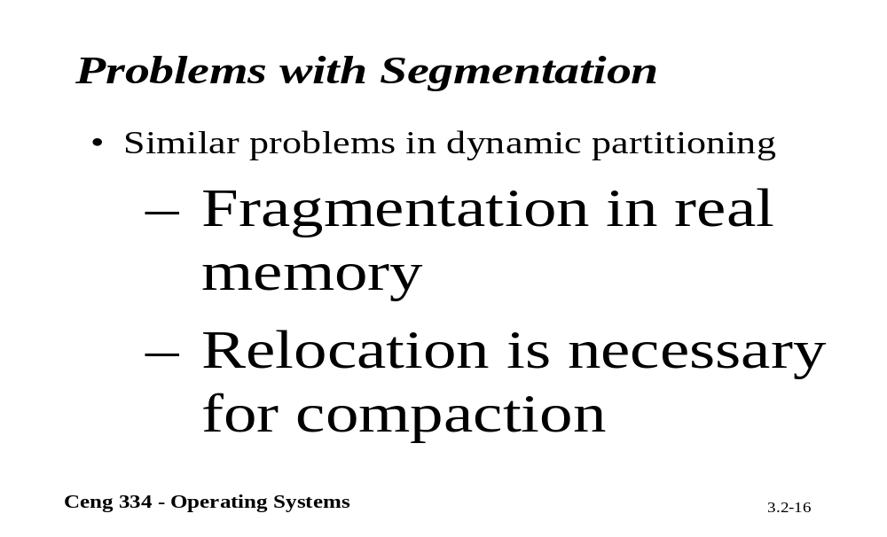
Problems with Segmentation

Slide 17
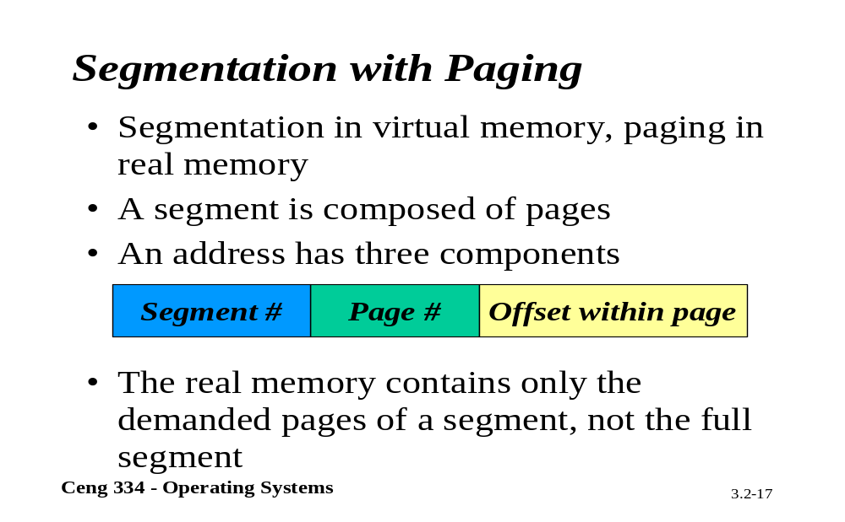
Segmentation with Paging

Slide 18
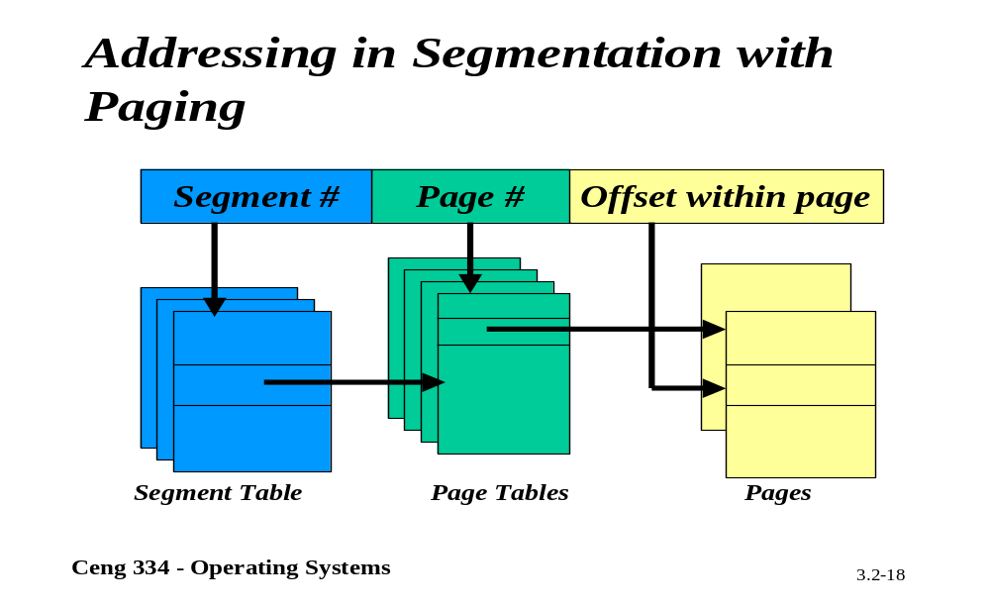
Addressing in Segmentation

Slide 19
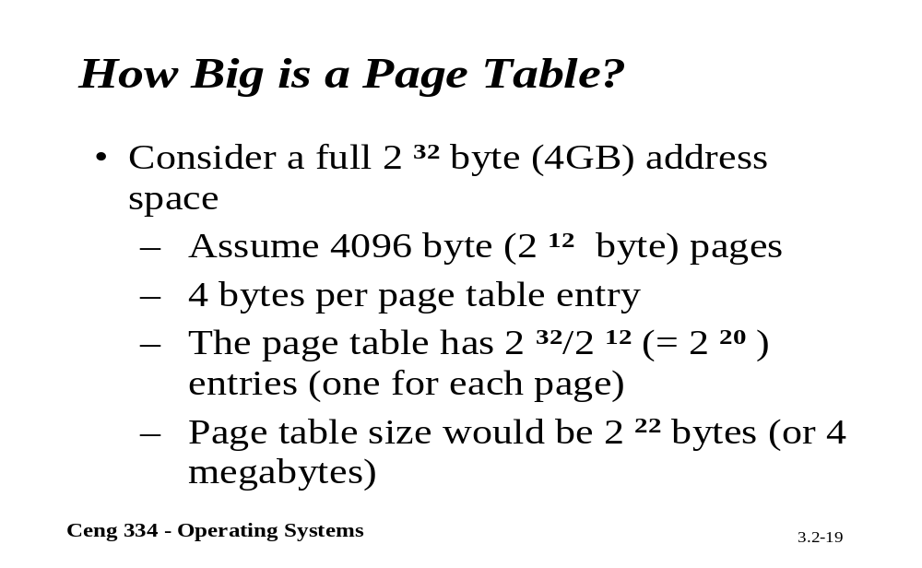
Page Table

Slide 20
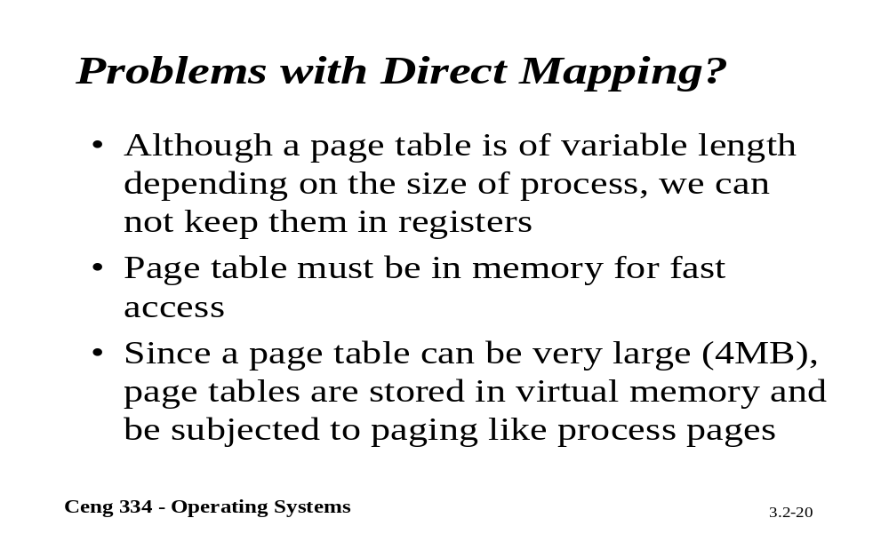
Direct Mapping

Slide 21
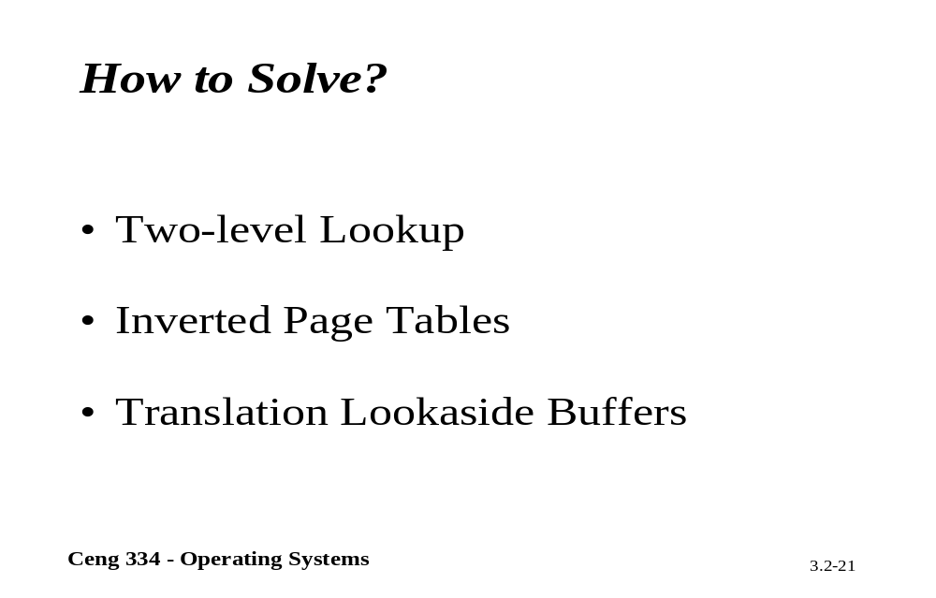
How to Solve?

Slide 22
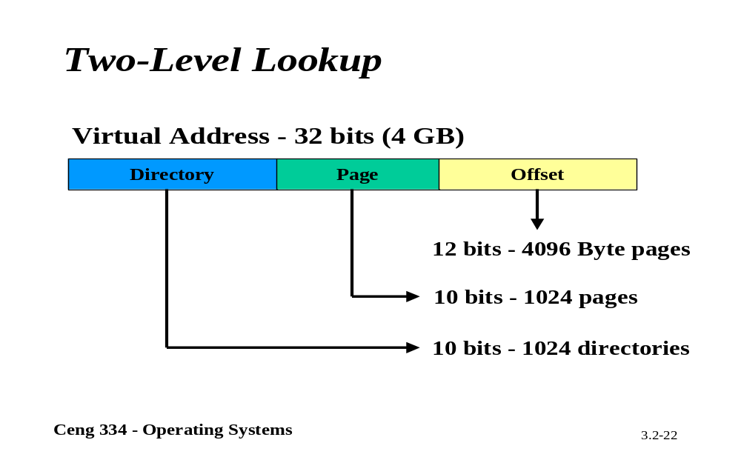
Two-Level Lookup

Slide 23
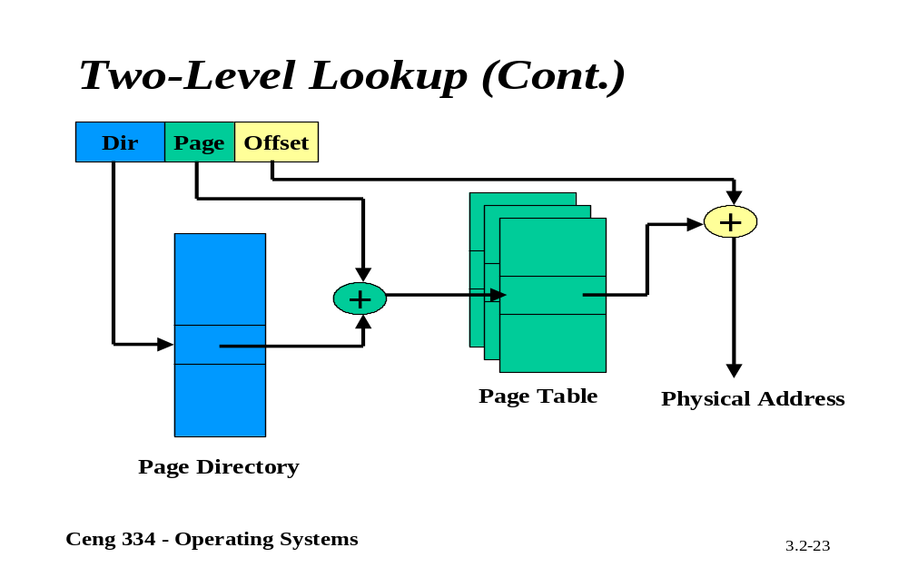
Two-Level Lookup

Slide 24
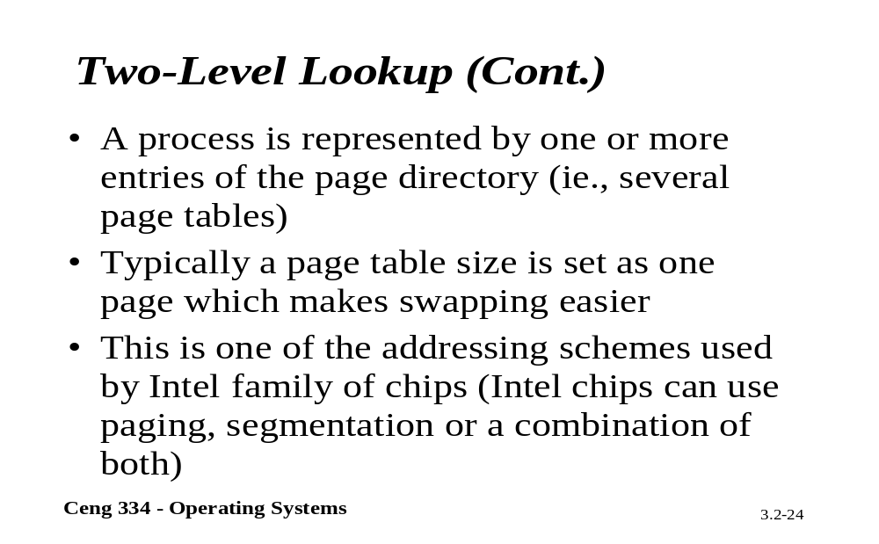
Two-Level Lookup

Slide 25
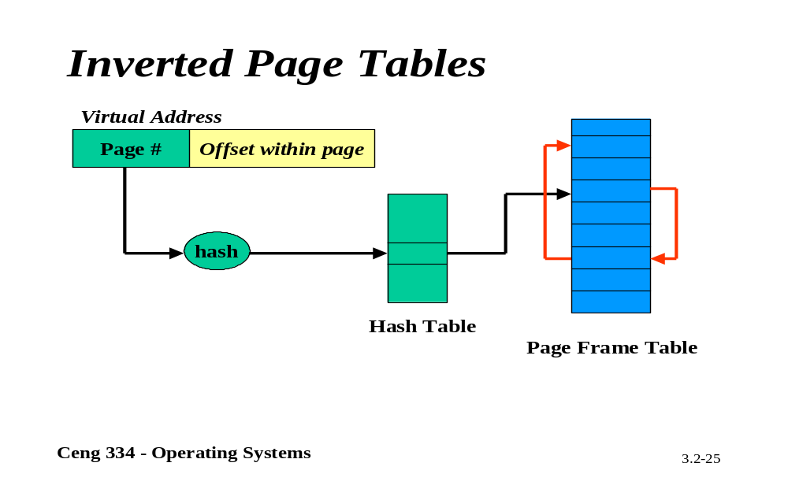
Inverted Page Tables

Slide 26
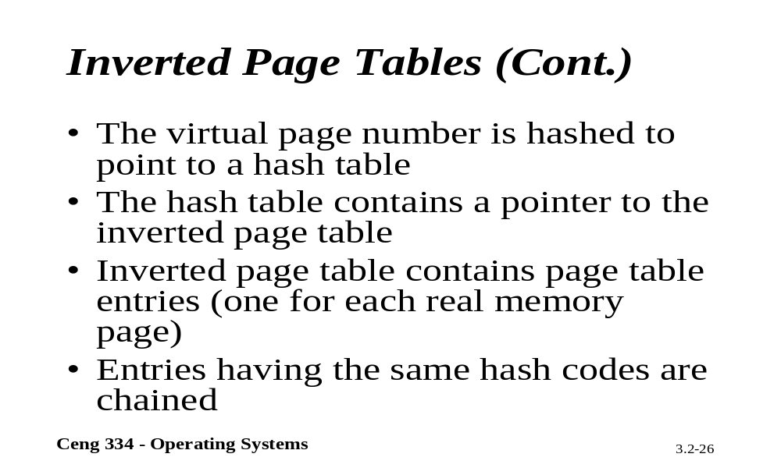
Inverted Page Tables

Slide 27
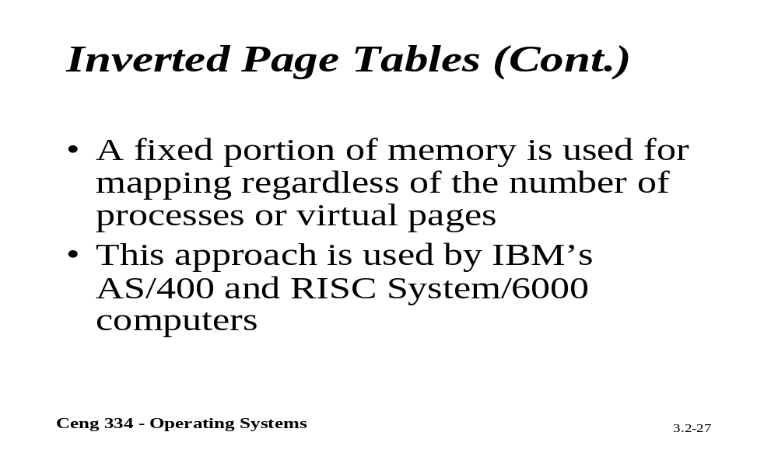
Inverted Page Tables

Slide 28
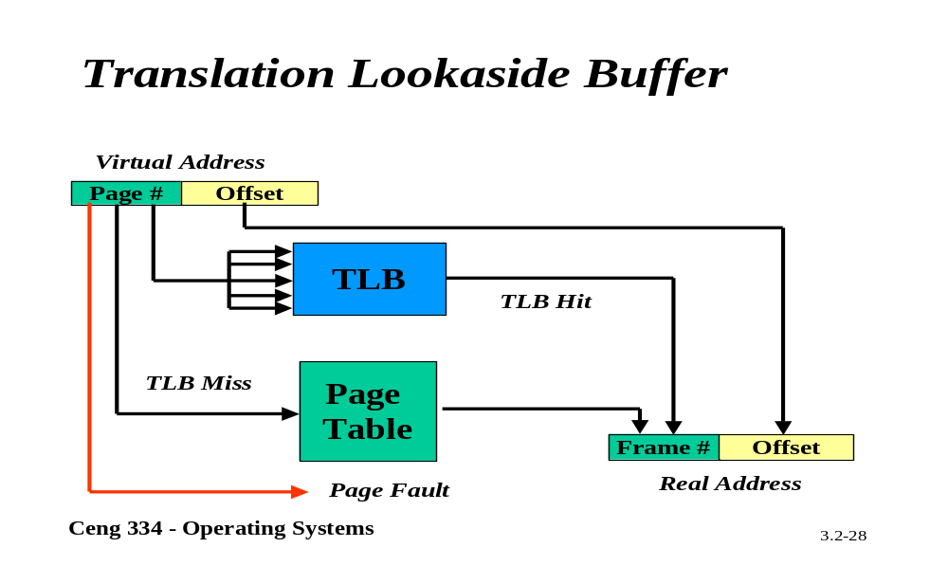
Translation Lookaside Buffer

Slide 29
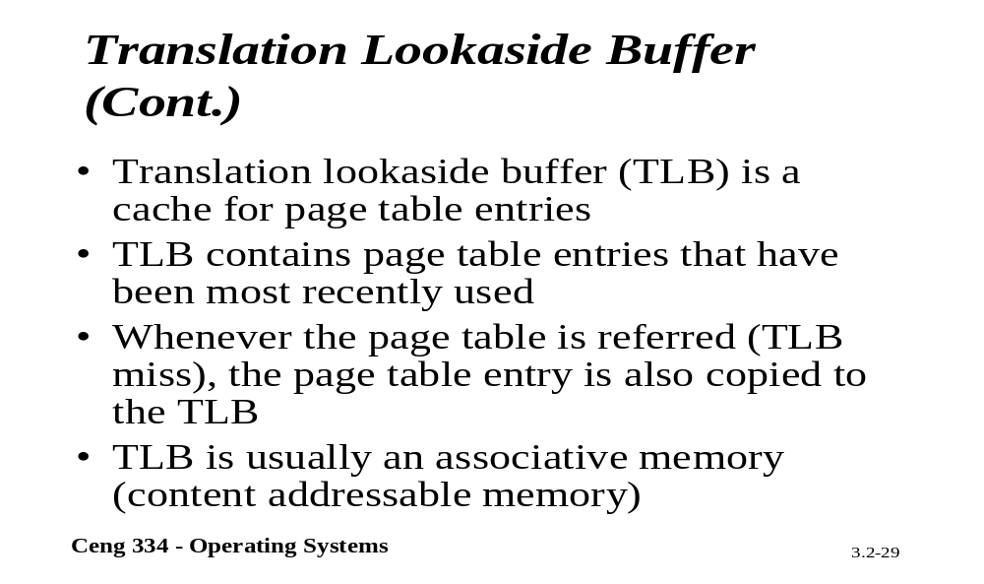
Translation Lookaside Buffer

